Slide 1

200 OK Present ‘Digital Krishi’
Hajur ko Prishram, hamro sath
Organized By Delta 4.0

Slide 2
Overview
01
02
Our services
Design and User Experience
03
04
Target audience
Conclusion

Slide 3
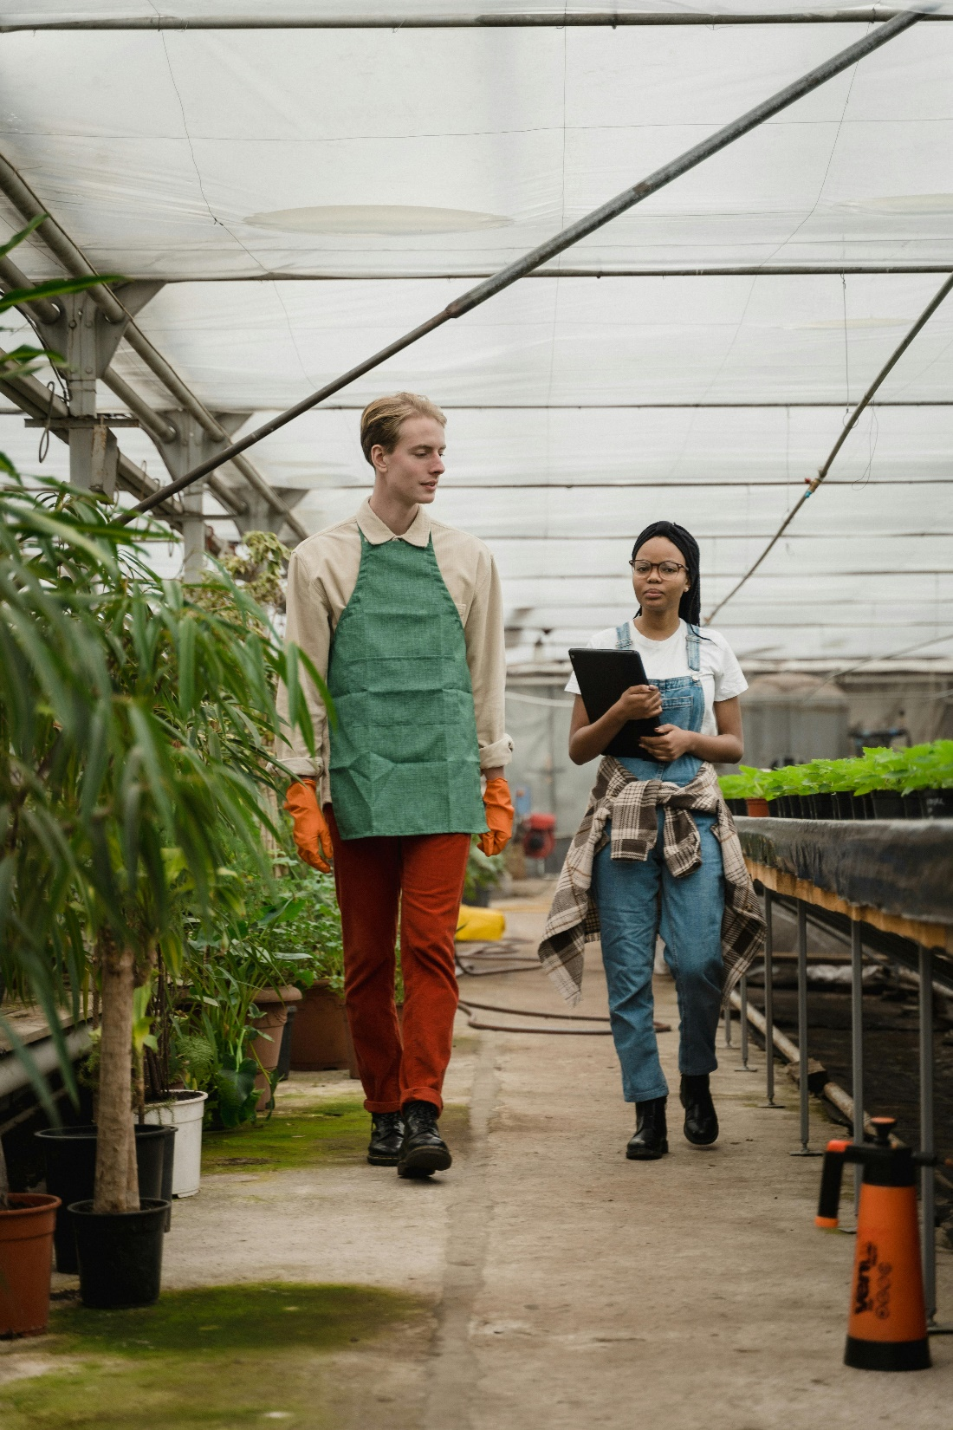
Introduction
Digital Krishi is designed to bring a revolution to the Nepalese agricultural context. Furthermore, it provides digital support and services for both users and farmers.

Slide 4
19,477,955

Slide 5
Our Services
Our project will help to over come those problems by
By giving correct information
Proper guidance for beginner
No middle man

Slide 6
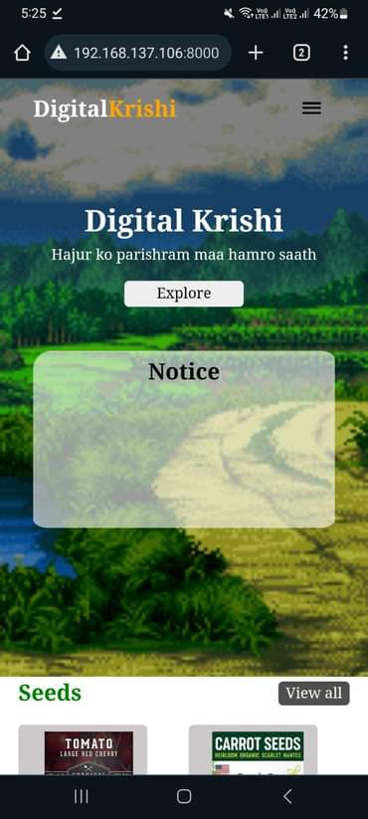
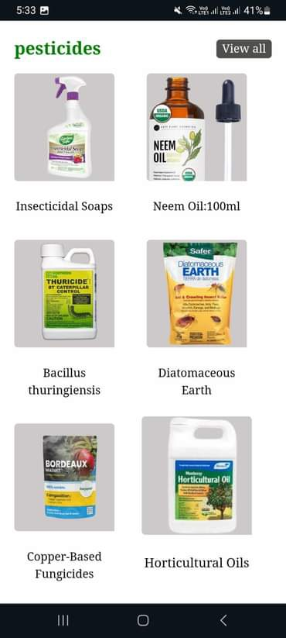
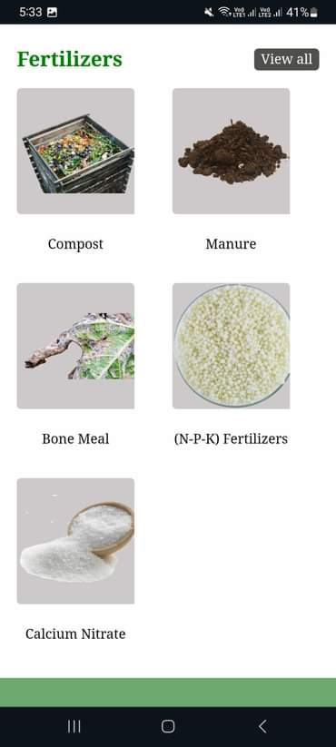
Design and User Experience

Slide 7
Demonstration

Slide 8

Target Audience
As our project is related to agriculture so
our target audience are farmers.

Slide 9
Business Model
Our project will help to improve
Efficiency,
Sustainability,
And productivity in the agricultural sector.(Digitally)

Slide 10
Conclusion
Introduction
Our services
Design And User Experience
Target Audience
Business model

Slide 11
Thanks!

